Slide 1

Labels & Guiding Marks
Notes:
The use of labels, tick marks, trend lines and similar graphical elements help provide important context about the data guide the viewer to see patterns. Patterns are only as useful as the viewer being able to translate these into meaningful information.

Slide 2

Reduce
Cognitive
Load
flickr cc 2.0
The Thinker by Gaby Av
Notes:
Reduce cognitive load through the use of labels, lines, and graphical marks.
Photo: https://www.flickr.com/photos/photogaby/6151904410/in/photolist-anC7Rq-7er8c-8p3ZjH-m4Njsr-dG8wx1-2WVdT1-fLTRSr-GfyzG-eJ9enK-eYrZXo-ciQDg9-7F4DNg-c1Pp7W-DJfsn-4vMd27-8WpM2U-4oedpp-fFidwc-hU86aD-5bRXdz-6LiPkP-62KzZb-dNTZkf-bE3dfr-b3wQwK-aXbvJX-6PWUha-fkw1y-4zD8tf-bCLegy-61WDh9-bE2af9-aUTi5z-kJ1nDw-o1bpxb-2jpqDi-ncSomG-8qhKiq-2giri-6kCPpU-jGTRY5-5YerwC-5JV6ug-r7nS2g-2vFAxN-5ye4tF-4CQGuP-7JTeCe-fGE4cQ-dCjb2F/

Slide 3
Always have a title
and label axes

Slide 4
[Placeholder for example image]

Slide 5
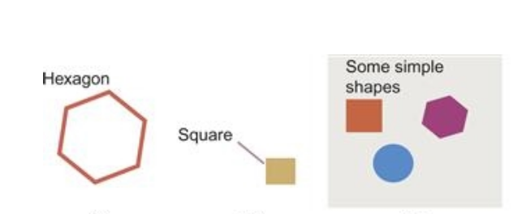
Use Gestalt Principles
Diagram from Ware, 2013
Notes:
GET HIGHER RES GRAPHIC!
Use of Gestalt Principles in connecting text labels with graphical elements. Here

Slide 6
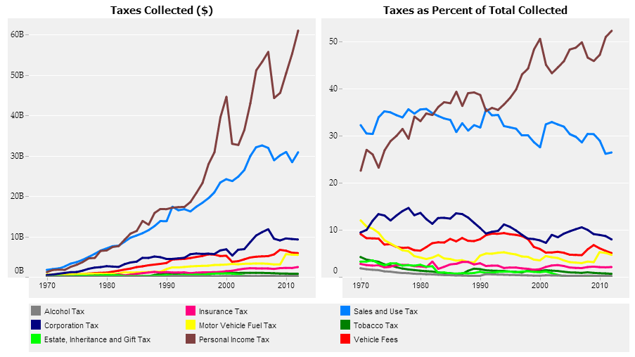
Poor
Notes:
https://public.tableau.com/s/sites/default/files/California%20Revenue%20History.png

Slide 7
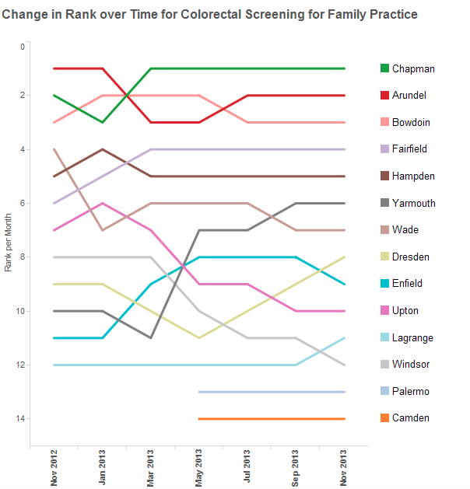
A Bit Better
Notes:
https://public.tableau.com/s/sites/default/files/rank11.png

Slide 8
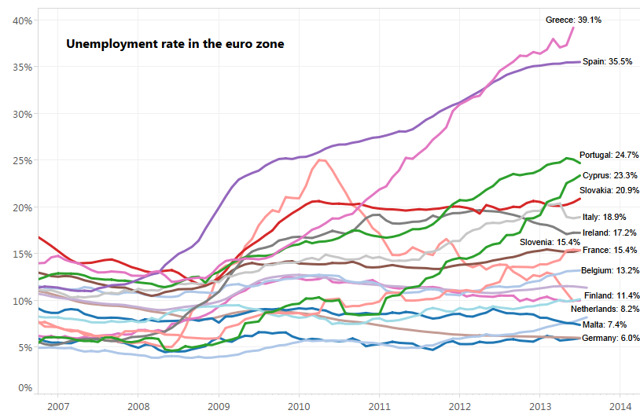
Best
Notes:
https://www.dataz.io/display/Public/2013/09/16/How+to+Create+a+Small+Multiple+Masterpiece+in+Tableau

Slide 9
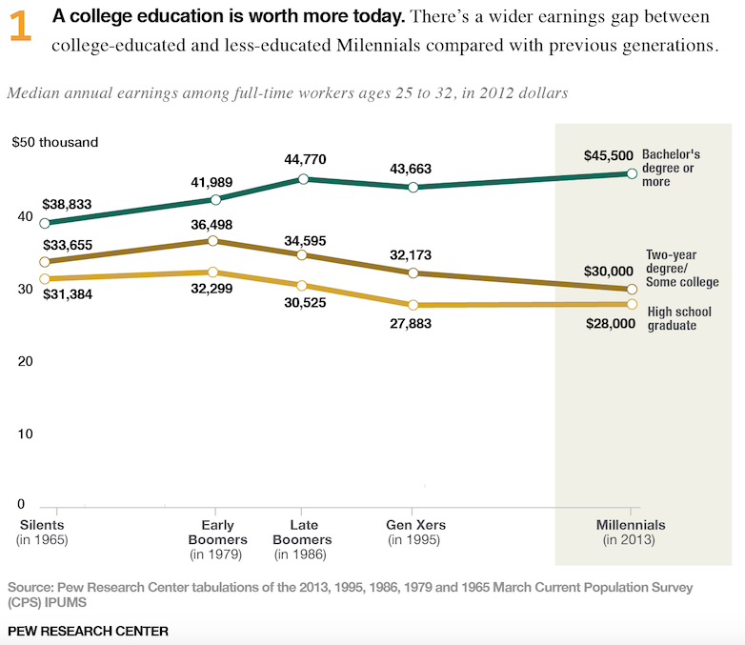

Slide 10
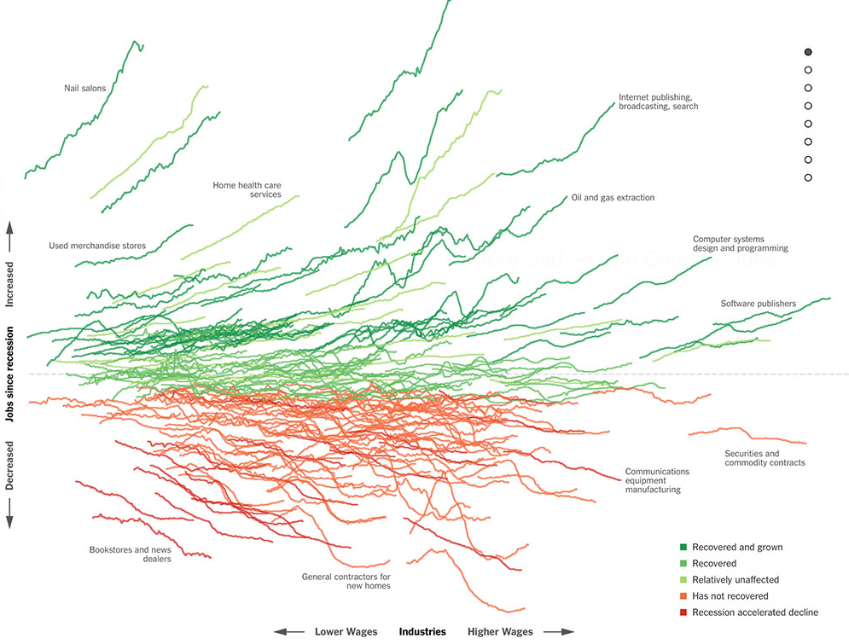
http://www.nytimes.com/interactive/2014/06/05/upshot/how-the-recession-reshaped-the-economy-in-255-charts.html
Notes:
Used well labels, tick marks, and trend lines impart critical information. Striking the right balance of when and where to label or provide guiding graphical marks can make or break the effectiveness of a vis. In this graph of the recession we can perceptually make out that there are trends in the lines and there are several different cdateogires

Slide 11
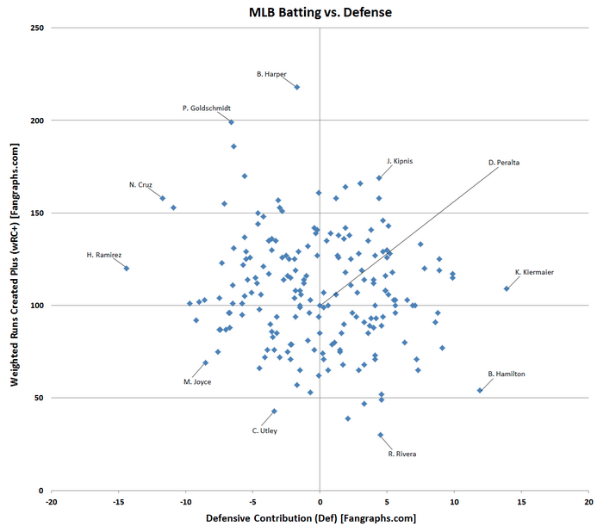
https://www.reddit.com/r/baseball/comments
/3b36et/2015_individual_player_hitting_vs_defense_scatter/
Notes:
Outliers

Slide 12
Don’t allow labels to interfere or clutter
Notes:
From Cleveland 1985

Slide 13
Take advantage of
perceptual abilities

Slide 14
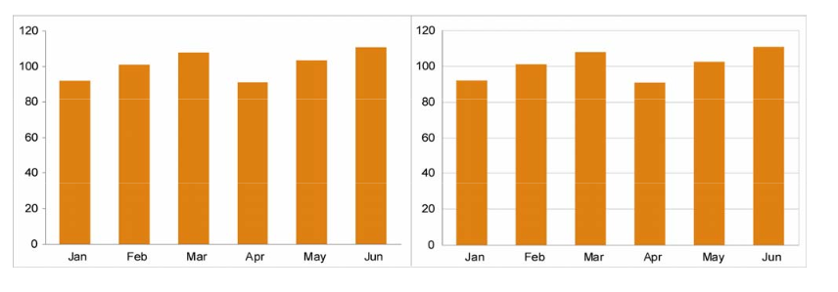
Grid Lines
[Example image]
Notes:
Gride lines are useful for marking subtle differences especially for quantitative comparison. Compare the months Feb. and May. This is due to Weber’s Law which states that we perceive differences between variations of a visual attributes, in this case height, as a ratio and not an absolute value. Image from https://www.perceptualedge.com/articles/dmreview/grid_lines.pdf

Slide 15
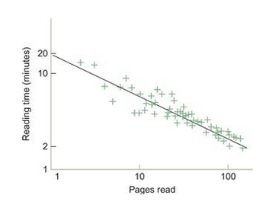
Power Law of Practice
Ware, C. Information Visualization, Perception for Design, 2013
Notes:
Both axes have logarithmic spacing here.
(In Ware)

Slide 16
Don’t just say it,
see it!
Notes:
Research on priming has shown that the use of visual examples for even familiar patterns is helpful [p.241 – 242 Ware, 2013]. When training a new analyst for patterns, don’t just provide a description of what you or team might be looking for, provide visual examples.

Slide 17
[placeholder for image]
Notes:
Image of example patterns

Slide 18
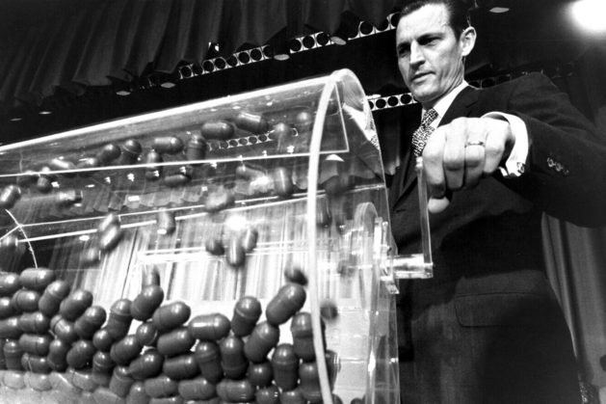
Showing
Patterns
Photo by
Selective Service System
]
Notes:
https://www.milwaukeemag.com/2013/06/27/FormerVietnamDraftChiefDies/

Slide 19

Notes:
EXAMPLE IMAGE NEED TO CITE REFERENCE. Provide historical reference here.

Slide 20
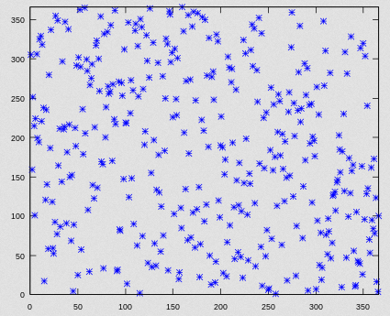
[Placeholder Image]

Slide 21
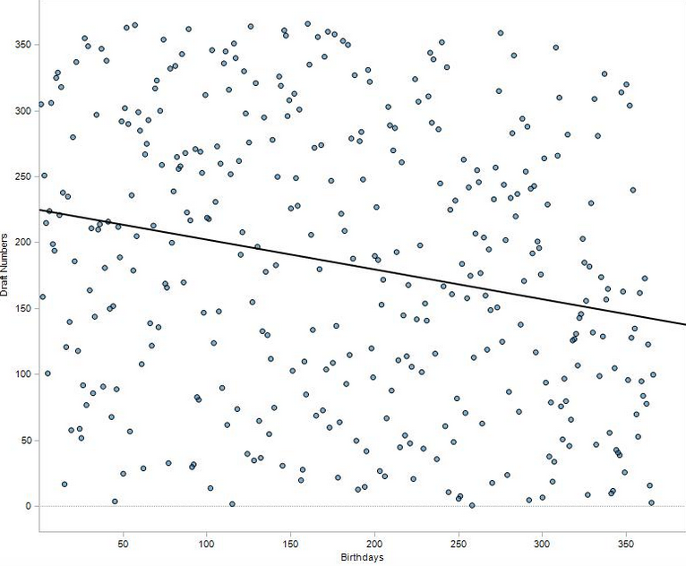
[Placeholder Image]
Notes:
Image sources: http://pharma-bi.com/2009/10/expanding-our-visual-vocabulary/

Slide 22
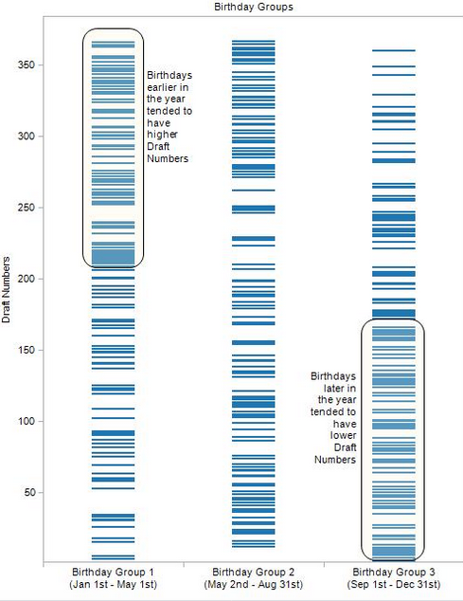
[Placeholder Image]

Slide 23
Always provide titles and label axes
Use direct labeling for emphasis or perceptual ease
Show important trends or patterns with lines and graphical marks
Keep it clean!
Notes:
Make sure the data stands out and that you are showing this first and foremost;
Provide adequate context through the use of labels, keys, and notes
Show trends when relevant through the use of reference lines or marks
Don’t clutter

Slide 24


